Slide 1
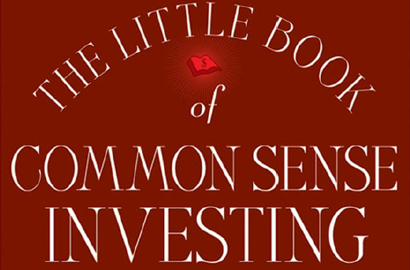
The Little Book of Common Sense Investing By: John C Bogle

Slide 2
“SUCCESSFUL INVESTING IS ALL about common sense. As the Oracle has said, it is simple, but it is not easy. Simple arithmetic suggests, and history confirms, that the winning strategy is to own all of the nation’s publicly held businesses at very low cost. By doing so you are guaranteed to capture almost the entire return that they generate. The best way to implement this strategy is indeed simple: Buying a fund that holds this market portfolio, and holding it forever. Such a fund is called an index fund.”

Slide 3
Index funds eliminate the risks of individual stocks, market sectors, and manager selection. Only stock market risk remains.

Slide 4
Please don’t underestimate the power of compounding the generous returns earned by our businesses. Over the past century, our corporations have earned a return on their capital of 9.5 percent per year. Compounded at that rate over a decade, each $1 initially invested grows to $2.48; over two decades, $6.14; over three decades, $15.22; over four decades, $37.72, and over five decades, $93.48.

Slide 5
The Man in The Middle
But the costs of playing the investment game both reduce the gains of the winners and increases the losses of the losers. So who wins? You know who wins. The man in the middle (actually, the men and women in the middle, the brokers, the investment bankers, the money managers, the marketers, the lawyers, the accountants, the operations departments of our financial system) is the only sure winner in the game of investing. Our financial croupiers always win. In the casino, the house always wins. In horse racing, the track always wins. In the Powerball lottery, the state always wins. Investing is no different. After the deduction of the costs of investing, beating the stock market is a loser’s game.
This book will tell you why you should stop contributing to the croupiers of the financial markets, who rake in something like $400 billion each year from you and your fellow investors. It will also tell you how easy it is to do just that: simply buy the entire stock market. Then, once you have bought your stocks, get out of the casino and stay out. Just hold the market portfolio forever. And that’s what the index fund does.

Slide 6
Once upon a Time...
A wealthy family named the Gotrocks, grown over the generations to include thousands of brothers, sisters, aunts, uncles, and cousins, owned 100 percent of every stock in the United States. Each year, they reaped the rewards of investing: all the earnings growth that those thousands of corporations generated and all the dividends that they distributed.
Each family member grew wealthier at the same pace, and all was harmonious. Their investment had compounded over the decades, creating enormous wealth, because the Gotrocks family was playing a winner’s game.
But after a while, a few fast-talking Helpers arrive on the scene, and they persuade some “smart” Gotrocks cousins that they can earn a larger share than the other relatives. These Helpers convince the cousins to sell some of their shares in the companies to other family members and to buy some shares of others from them in return. The Helpers handle the transactions, and as brokers, they receive commissions for their services. The ownership is thus rearranged among the family members. To their surprise, however, the family wealth begins to grow at a slower pace. Why? Because some of the return is now consumed by the Helpers, and the family’s share of the generous pie that U.S. industry bakes each year 100 percent at the outset, starts to decline, simply because some of the return is now consumed by the Helpers.
The smart cousins quickly realize that their plan has actually diminished the rate of growth in the family’s wealth. They recognize that their foray into stock-picking has been a failure and conclude that they need professional assistance, the better to pick the right stocks for themselves. So they hire stock-picking experts—more Helpers!—to gain an advantage. These money managers charge a fee for their services. So when the family appraises its wealth a year later, it finds that its share of the pie has diminished even further.

Slide 7
Once upon a Time... (Continued)
Alarmed at last, the family sits down together and takes stock of the events that have transpired since some of them began to try to outsmart the others. “How is it,” they ask, “that our original 100 percent share of the pie— made up each year of all those dividends and earnings— has dwindled to just 60 percent?” Their wisest member, a sage old uncle, softly responds: “All that money you’ve
paid to those Helpers and all those unnecessary extra taxes you’re paying come directly out of our family’s total earnings and dividends. Go back to square one, and do so immediately. Get rid of all your brokers. Get rid of all your money managers. Get rid of all your consultants. Then our family will again reap 100 percent of however large a pie that corporate America bakes for us, year after year.”
They followed the old uncle’s wise advice, returning to their original passive but productive strategy, holding all the stocks of corporate America, and standing pat. That is exactly what an index fund does.
. . . and the Gotrocks Family Lived Happily Ever After

Slide 8
The way to wealth for those in the business of investment is to persuade their clients, “Don’t just stand there. Do something.”
But the way to wealth for their clients in the aggregate is to follow the opposite maxim: “Don’t do something. Just stand there.”

Slide 9
The Investor Emotions
We can measure the emotions of the investors by the price/earnings (P/E) ratio, which measures the number of dollars investors are willing to pay for each dollar of earnings. As investor confidence waxes and wanes, P/E multiples rise and fall. When greed holds sway, we see very high P/Es.
When hope prevails, P/Es are moderate. When fear is in the saddle, P/Es are very low. Back and forth, over and over again, swings in the emotions of investors momentarily derail the steady long-range upward trend in the economics of investing.

Slide 10
Reversion to Mean
Curiously, without exception, every decade of significantly negative speculative return was immediately followed by a decade in which it turned positive by a correlative amount—the quiet 1910s and then the roaring 1920s, the dispiriting 1940s and then the booming 1950s, the discouraging 1970s and
then the soaring 1980s—reversion to the mean (RTM) writ large. (Reversion to the mean can be thought of as the tendency for stock returns to return to their long-term norms over time—periods of exceptional returns tend to be followed by periods of below average performance, and vice versa.)

Slide 11
Noise of the Emotions
My advice to investors is to ignore the short-term noise of the emotions reflected in our financial markets and focus on the productive long-term economics of our corporate businesses. Shakespeare could have been describing the inexplicable hourly and daily—sometimes even yearly or longer—fluctuations in the stock market when he wrote, “[It is] like a tale told by an idiot, full of sound and fury, signifying nothing.” The way to investment success is to get out of the expectations market of stock prices and cast your lot with the real market of business.

Slide 12
From the chapter:
“How Most Investors Turn a Winner’s Game into a Loser’s Game”
All investors as a group must necessarily earn precisely the market return, but only before the costs of investing are deducted.
There are, then, these two certainties:
(1) Beating the market before costs is a zero-sum game;
(2) Beating the market after costs is a loser’s game.

Slide 13
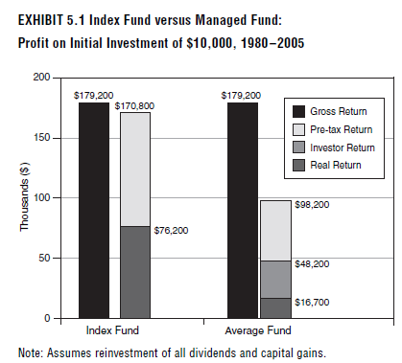
Thank You
By: Ashish Jain

